Slide 1
Fast API Flutter SQLite
Leon Abbad Bari Giovano E41241780

Slide 2
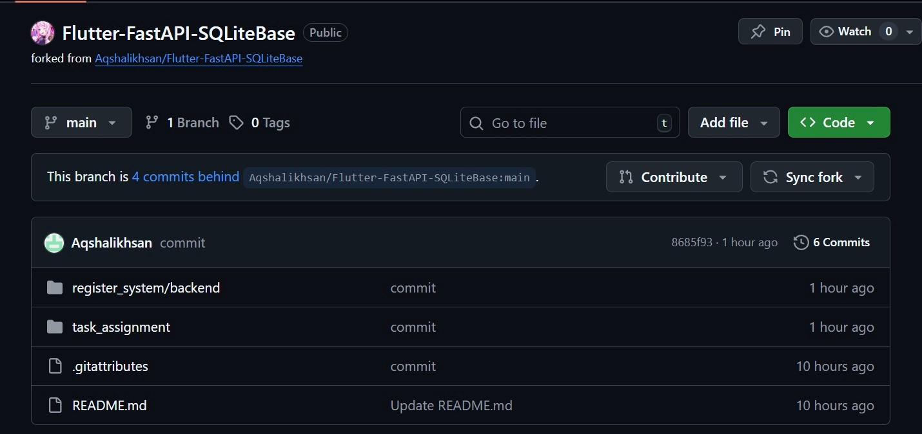
Fork Repository

Slide 3
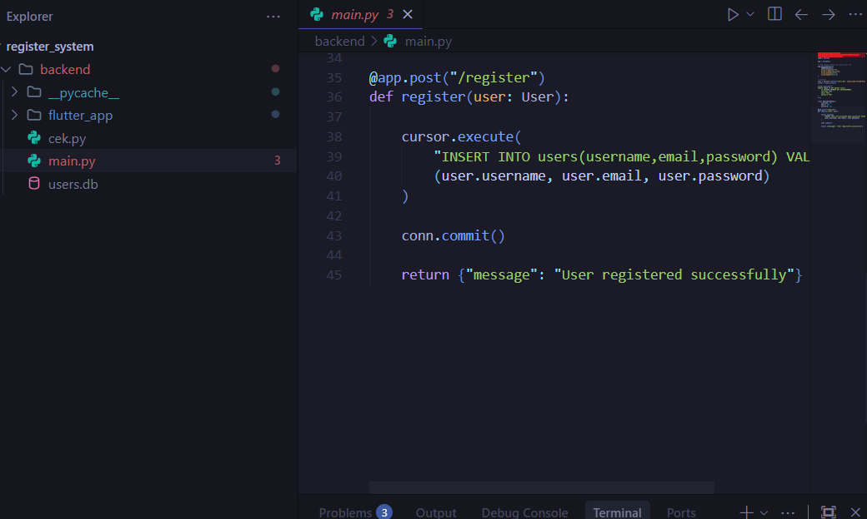
Clone Repo ke Vscode

Slide 4
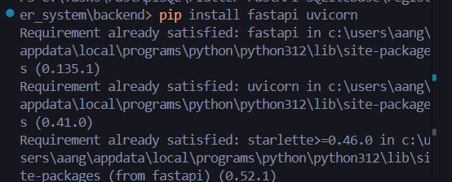
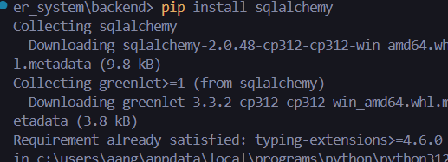
Instalasi Library Python
Install Fast Api Uvicorn dan sqlalchemy menggunakan package pip

Slide 5
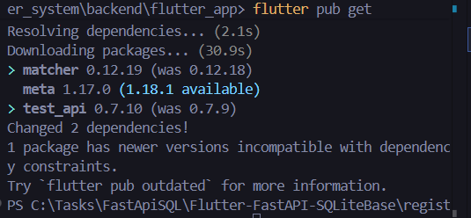
Run Flutter Pub Get

Slide 6
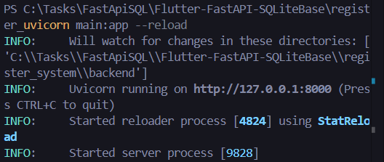
Run Backend Server

Slide 7
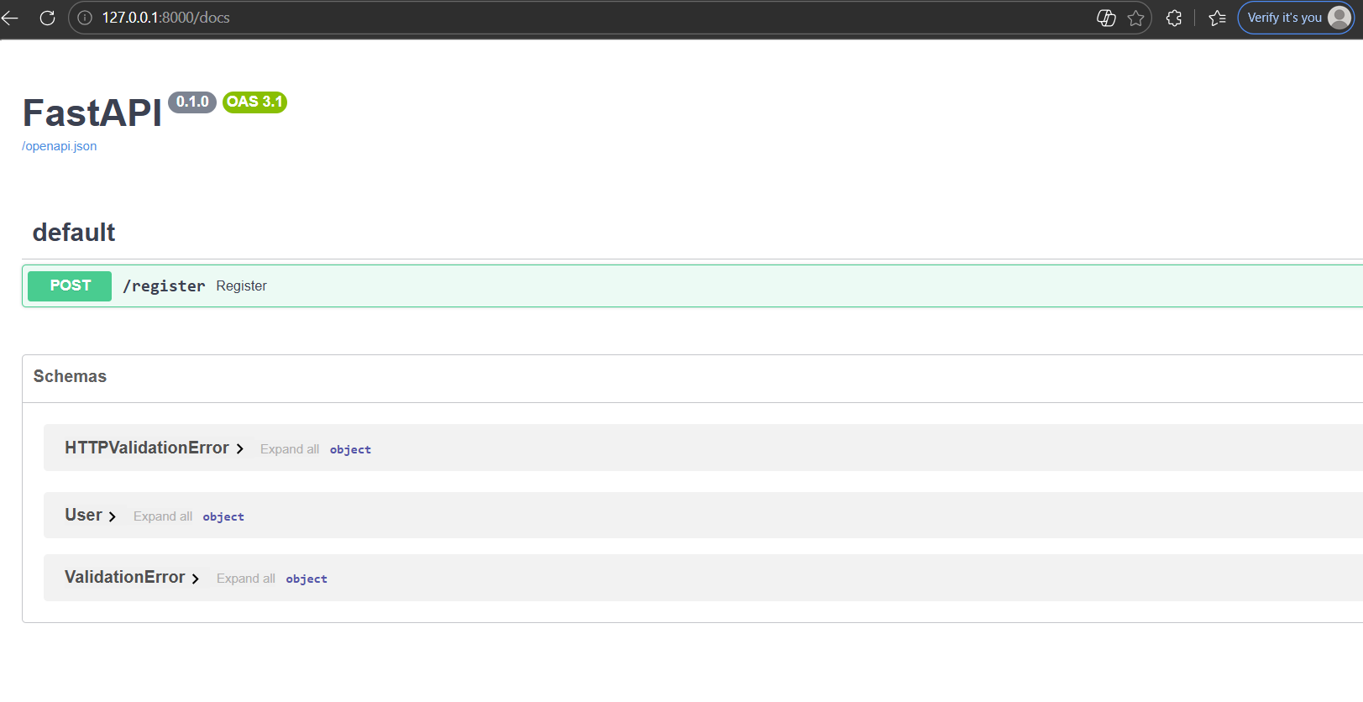
Buka port server di web

Slide 8
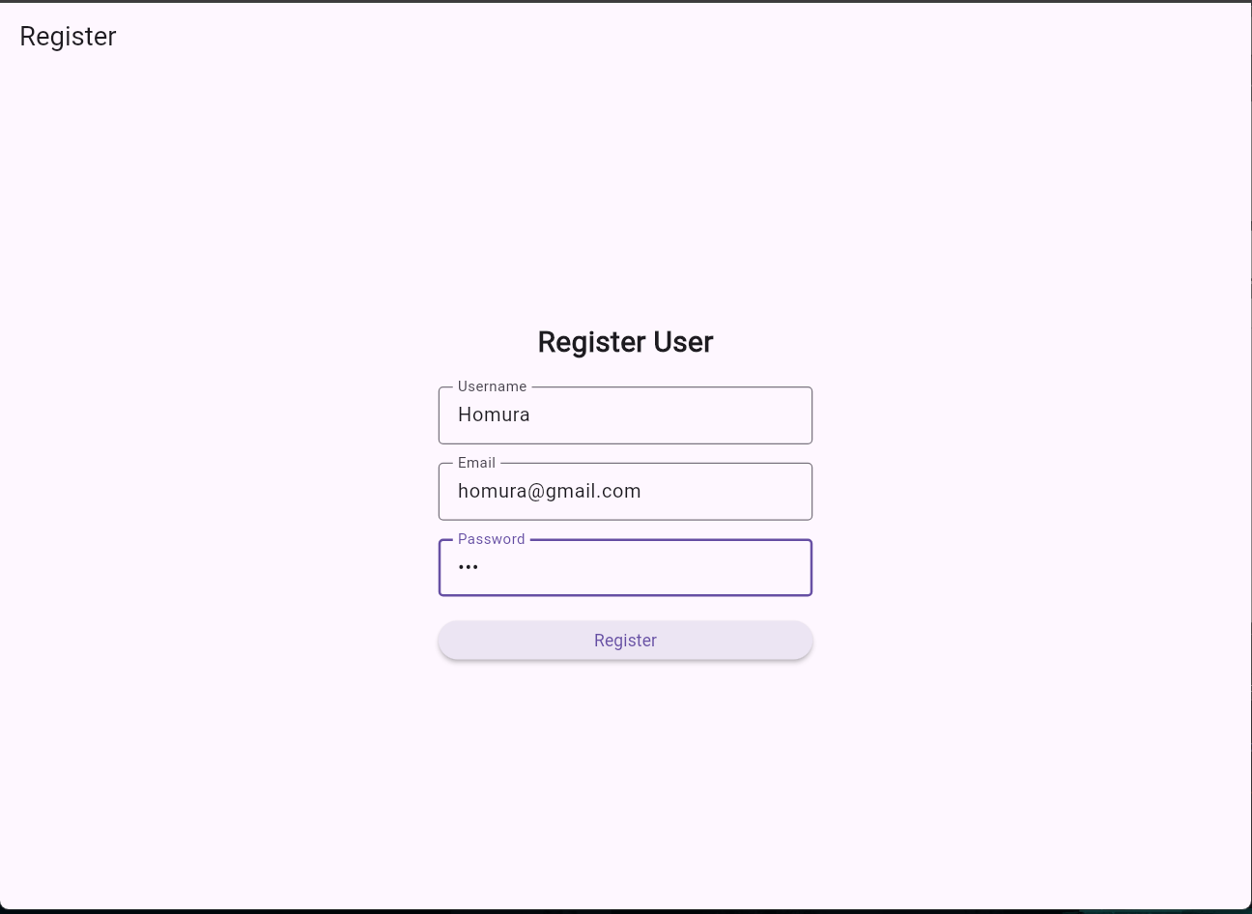
Run Flutter dan Input Data Register

Slide 9
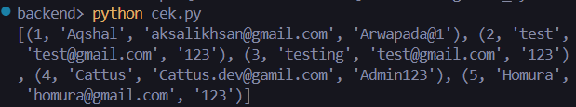
Cek di database menggunakan cek.py

